Slide 1
SCIENCE & ENGINEERING BUSINESS ASSOCIATION
General Body Meeting, 11/2

Slide 2
Meeting Agenda
Current Events
Networking
Stock Competition

Slide 3
Current Events

Slide 4
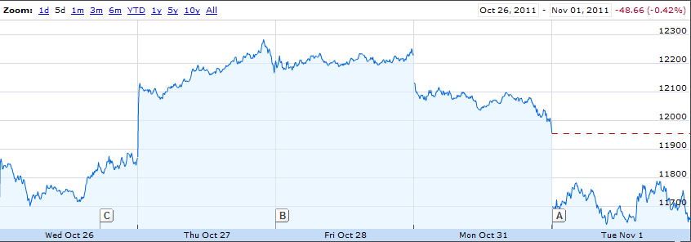
Stock Market
Dow Jones Industrial Average

Slide 5
Stock Market
End of last week’s growth negated by last few days
S&P500, NASDAQ also down significantly
Investors have little faith in the stability of Greece and the euro zone crisis

Slide 6
Gaddafi
General Muammar Gaddafi
June 1942- October 20, 2011
Accused of spending much of Libya’s natural resources and high gross domestic product on his family and elites

Slide 7
Libyan Civil War
February 18, 2011 – October 23, 2011
Began with peaceful Arab Spring protests Benghazi then escalated
Similar violence in Misrata and Tripoli sparked civil war
Notes:
Wikipedia!!!!!!!!!!!
http://en.wikipedia.org/wiki/Timeline_of_the_2011_Libyan_civil_war
Gov. killed 14 protesters one day then 24 the next at a funeral procession

Slide 8
Intervention
UN declares a no-fly zone over Libya
Gaddafi declares a ceasefire but a few hours later it is reported that the fighting continued
NATO begins enforcing a blockade as US, French, British, and Italian air forces attack Libyan air and ground defense

Slide 9
Closing
October 17, 2011
Rebels have officially expelled all Pro-Gaddafi forces
October 20, 2011
General Gaddafi is captured and killed

Slide 10
Euro Zone rescue
Leaders of euro zone got together Oct 27 and agreed upon a package to fix the crisis by restoring banks and help borrowers
Still many holes, disastrous outcomes still possible including a Greece default, failure to bail out other nations, or money ultimately leaving Europe

Slide 11
Real Estate
Recovery since rock bottom three years ago has stalled
Lack of jobs has resulted in poor demand for new office spaces/consumer spending locations
Home prices barely rose in August, down 3% from last year

Slide 12
Networking

Slide 13
Table of Contents
Networking Events
Info Sessions
Career Fair
Follow Up
Emails
Social Media
Facebook
Linkedin

Slide 14
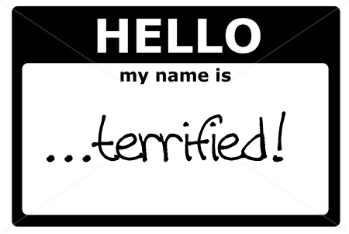

Networking Events
Preparation
Research Company
Possible positions
Possible career paths
Company Culture
Purpose
Core Values
Build list of questions

Slide 15
Info Sessions
Format
Presentation
Questions
Don't be that guy
Networking
Attire
Rule of Thumb
Dress a little nicer than the employer will be dressed
Better to be overdressed than under-dressed

Slide 16
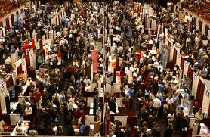
Career Fair
Overwhelming?
200+ employers
Free Stuff
Come with a plan
List all companies that you wish to see
Plan path between booths to not appear to wonder aimlessly

Slide 17

Career Fair
Approaching a table
Wait in line
Smile and handshake
Introduction
Name
Major
Job Interested In
Questions
Resume (not always)
Business Card

Slide 18
Follow Up Emails
Dear Mr. Powers,
Thank you for allowing me the opportunity to apply to C&G. Just to let you know, I have submitted my application for the Co-op position (MFG00002645) for next fall, instead of the Summer Internship Program. Cornell's Experience website did not allow me the chance to specify which position I was applying for.
Thanks again and hope to hear from you soon.
Sincerely,
Charlie Brown
Cornell Chemical Engineering, 2013
cb5@cornell.edu
111-222-3333

Slide 19
Follow Up Emails
Tips:
The obvious
Grammar and spelling
Structure
Salutation
Introduction
Get to the point
Thank you
Email Signature
Full Name
Email
Major
School
Year
Phone Number
Charles Brett Provenzano
cbp45@cornell.edu
Chemical Engineering
Cornell University
Class of 2013
(713)817-8681

Slide 20
Follow Up Emails
Non-obvious points
Always include a subject
Check junk mail for responses
Go easy on attachments
Ask for response at "your convenience"
Do not use full caps

Slide 21
Follow Up Emails
Dear Hiren Shah,
I received your contact information from Cornell's online recruiting database, so I decided to write you a quick note about a mistake I made in my application. While uploading my cover letter to the Exxon career site, I mistakenly uploaded the wrong cover letter. I am very sorry for the mistake and hope it does not jeopardize the opportunity to apply for an internship at Exxon Mobil.
Please let me know how I can remove this cover letter from my already submitted application, or if any other opportunities exist to rectify this mishap.
Thanks,
Charles Provenzano
Cornell University
Chemical Engineering
Class of 2013

Slide 22
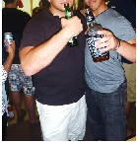
Social Media: Do not be that Guy
Facebook: Nothing Positive

Slide 23

Social Media: Linkedin.com
Connect with people
Upload Resume
Build "Network"
Add Cornell SEBA

Slide 24
Stock Competition!

Slide 25
Virtual Stock Exchange
Hosted by MarketWatch which is owned by Wall Street Journal
Provides great resources for company research

Slide 26
Signing Up
Will send these instructions out on email:
1) google “vse” and find MarketWatch
2) click log in
3) click register
4) fill in your info
Doesn’t really matter what your info is but might make it easier to figure out who’s who if you use your netid
5) get your confirmation email

Slide 27
Joining Our Game
6) go on marketwatch.com and click games
7) click find a game
8) type in Cornell Seba
It’s case sensitive
9) click the link for our game
10) enter the password: SEBA_2011
Case sensitive again

Slide 28
Game Info
Game ends: 5/4/2012
Starting balance: $100,000
Commission: $10.00/trade
Min/max purchase: $2.00/$500,000
Portfolios are public
Short selling is allowed
Margin selling is not allowed
Notes:
Short selling – hoping that price drops. “borrow” stock, sell it, rebuy when the price changes +/-, return stock to original owner
Margin selling – what hedge fund companies do. Take out massive loans and use that along with rich owner’s money to invest absurd amounds and have huge profits or losses

Slide 29
Investing Resources
MarketWatch and Wall Street Journal
Reuters
New York Times business section

Slide 30
Price Quotes
MarketWatch
Finance.yahoo.com
Google
Need to know stock abbreviation

Slide 31
Basic Investing
70% stock
30% mutual fund
Numbers aren’t exact just play around it’s a game after all

Slide 32
Basic Investing
70% stock
30% mutual fund
Numbers aren’t exact just play around it’s a game after all

Slide 33
Questions?

